Slide 1
Introduction to Python
Dr. Noman Islam

Slide 2
Print
In Python, the command print tells the program to display words or numbers on the screen
Keywords
String

Slide 3
Variables
name=“Noman”
Variables can change their values
With variables, Python is blind to semantics
Give your variables meaningful names
You can have spaces between variable assignments:
nickname = "Bub“
Variable names can't have spaces in them

Slide 4
Variables for numbers
weight = 150
Consider
original_num = 23
new_num = original_num + 7
Python substitutes the original_number with value 23
original_num = original_num + 10
A variable can start out as one type of variable, then become another type of variable.

Slide 5
Variable names
1st_prime_number = 2 is illegal. Why?
prime_number_that_comes1st = 2 is legal

Slide 6
Math expressions
+, -, *, /
popular_number = 2 + 2
sum_of_numbers = num + another_num

Slide 7
Legal and illegal variable names
You can't enclose variable names in quotation marks.
You can't have any spaces in it.
It can't be a number or begin with a number
A variable can't be any of Python's reserved words, also known as keywords

Slide 8
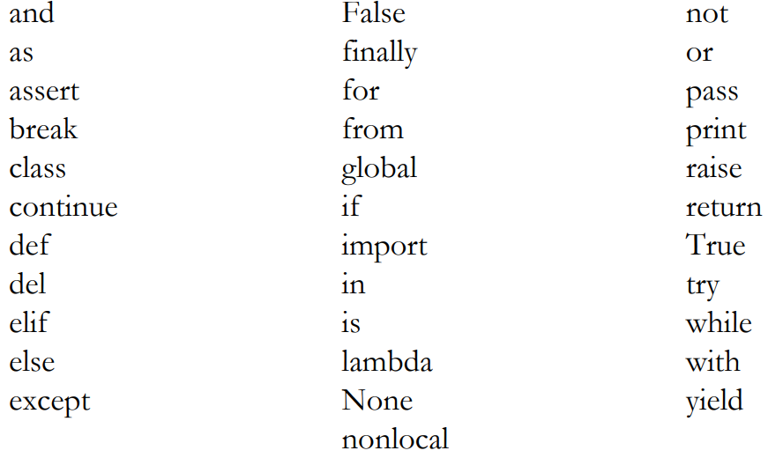
Python keywords

Slide 9
Variable names are case-sensitive
Python's governing body recommends breaking up multi-word variables with underscores
You should balance readability with conciseness

Slide 10
Unfamiliar operators
whats_left_over = 10 % 3
% is the modulo operator.
age += 1
age -= 2
age *= 3

Slide 11
Math Expressions: Eliminating ambiguity
total_cost = 1 + 3 * 4
In Python, as in algebra, the ambiguity is cleared up by precedence rules
Multiplication operations are completed before addition operations
Parentheses override all the other precedence rules.

Slide 12
Concatenating text strings
greeting = "Hello"
addressee = "World“
whole_greeting = greeting + addressee
You can use the plus sign to sum numbers, and you can use it to concatenate strings
But you can't use the plus sign to combine strings and numbers
print("The sum of 2 plus 2 is " + 4)

Slide 13
If statements
if species == "cat":
print("Yep, it's cat.")
Note that it's two equal signs, ==, not one
if 2 + 2 == 4:
print("Everything makes sense.")
Indentation is very important

Slide 14
Comparison operators
== is a type of comparison operator, specifically it's the equality operator
!=
>
<
>=
<=

Slide 15
else and elif
Often, you want something to happen either way
Statements that execute in the else case are indented
Finally, there's elif. It's short for else if. If no test has been successful yet, an elif tries something else.

Slide 16
Testing set of conditions
You can test for a combination of conditions in Python by using the keyword and
You can also create a test that passes if any condition is met. The keyword is or.
You can combine any number of and and or conditions

Slide 17
If statements nested
Nest levels are communicated to Python by indentations

Slide 18
Comments
Comments are lines of text in your code that Python ignores
A comment can help you figure out your code when you come back to it a month or a year later
To write a comment, begin with #. For readability, add a space after the #

Slide 19
Lists
A list is a variable that can have a sequence of values assigned to it
In a list, these values are known as elements
cities = ["Atlanta", "Baltimore", "Chicago“]
The first element in a list always has an index of 0, the second element an index of 1, and so on
You can even mix the different types of values in the same list

Slide 20
Adding and changing elements in list
cities.append("New York")
There's an alternative way to append. It allows you to add one or more elements to a list:
cities = cities + ["Dubuque", "New Orleans"]
todays_tasks = []
If I want to insert "New York" at the beginning of the list, I write:
cities.insert(0, "New York")

Slide 21
Lists: Taking slices out of them
cities[2:5]
smaller_list_of_cities = cities[:5]
smaller_list_of_cities = cities[2:]

Slide 22
Lists: Deleting and removing elements
del tasks[0]
tasks.remove("call Sarah")

Slide 23
Lists: popping elements
latest_task_accomplished = tasks.pop(1)
To pop the last element in a list, skip the index number
tasks_accomplished.insert(1, tasks.pop(1))

Slide 24
Tuples
They can't be changed—unless you redefine the whole tuple
states_in_order_of_founding = ("Delaware", "Pennsylvania", "New Jersey", "Georgia")

Slide 25
Tuple
A tuple-pronounced "toople" by some people and "tupple" by others-is like a list, but the elements are fixed
Example:
states_in_order_of_founding = ("Delaware", "Pennsylvania", "New Jersey", "Georgia")
A tuple starts numbering at 0
You can't add, modify, remove, delete, or pop

Slide 26
For loop
for a_clean_city in cleanest_cities:
if city_to_check == a_clean_city:
print("It's one of the cleanest cities")
If Python finds a match, there's no point in continuing the loop. So you stop the loop by adding a break statement

Slide 27
Nested loop
for a_first_name in first_names:
for a_last_name in last_names:
full_names.append(a_first_name + " " + a_last_name)

Slide 28
Input
input()
int()
float()
str()

Slide 29
Changing case
lower()
upper()
title()

Slide 30
Dictionaries
A dictionary works something like a list, but instead of a simple series of things, a dictionary is a series of pairs of things
Each pair contains a key and a value
customer_29876 = {"first name": "David", "last name": "Elliott", "address": "4803 Wellesley St."}
customer_29876["address"]
But keys don't have to be strings. They can be numbers

Slide 31
Adding items in dictionary
customer_29876["city"] = "Toronto“
Empty dictionary
things_to_remember = {}

Slide 32
Removing and changing elements
del customer_29876["address"]
customer_29876["city"] = "Winipeg”

Slide 33
Looping through dictionary
for each_value in customer_29876.values():
print(each_value)
for each_key in customer_29876.keys():
print(each_key)
for each_key, each_value in customer_29876.items():
print("The customer's " + each_key + " is " + each_value)

Slide 34
List of dictionary
Defining a list of dictionary
Picking up values
Length of customers
Append

Slide 35
Dictionary of list
customer_29876 = {"first name": "David", "last name": "Elliott", "address": "4803 Wellesley St.", "discounts": ["standard", "volume", "loyalty"]}
in keyword

Slide 36
Dictionary of dictionary
customers = { "johnog": {"first name":"John", "last name": "Ogden", "address": "301 Arbor Rd." }, "coder1200": {"first name":"Ann", "last name": "Sattermyer", "address": "PO Box 1145" }, "madmaxine": {"first name":"Jill", "last name": "Somers", "address": "3 Main St." }
}

Slide 37
Functions
A function is a block of Python code that robotically does the same thing again and again, whenever you invoke its name
def add_numbers():
first_number = 2
second_number = 3
total = first_number + second_number
print(total)
add_numbers()
Note: The function definition must come before the function call.

Slide 38
Passing arguments to function
def add_numbers(first_number, second_number):
total = first_number + second_number
print(total)
add_numbers(1.11, 2.22)
positional arguments

Slide 39
Keyword arguments
def say_names_of_couple(husband_name, wife_name):
print("The names of the couple are " + husband_name + " and " + wife_name)
say_names_of_couple(husband_name="Bill", wife_name="Zelda")

Slide 40
Assigning default values
def calc_tax(sales_total, tax_rate=.04):
print(sales_total * tax_rate)
You can mix positional arguments and keyword arguments. For example, you can code… give_greeting("Hello there", first_name="Al”)
Positional arguments must come before keyword arguments
Lists and dictionaries, as well as strings and numbers, can be arguments passed to a function

Slide 41
Unknown number of arguments
def display_result(winner, score, **other_info):
print("The winner was " + winner)
print("The score was " + score)
for key, value in other_info.items():
print(key + ": " + value)
display_result(winner="Real Madrid", score="1-0", overtime ="yes", injuries="none")
The two asterisks followed by a parameter name mean that there may or may not be one or more extra arguments passed.

Slide 42
Positional arguments can be optional as well. To handle optional positional arguments, you use a single asterisk
def display_nums(first_num, second_num, *opt_nums):
print(first_num)
print(second_num)
print(opt_nums)
display_nums(100, 200, 300, 400, 500)

Slide 43
Passing information back from functions
def calc_tax(sales_total, tax_rate):
tax = sales_total * tax_rate
return tax
sales_tax = calc_tax(sales_total=101.37, tax_rate=.05)
print(sales_tax)

Slide 44
Using functions as variables
print(calc_tax(sales_total=101.37, tax_rate=.05))
result_of_adding = add_numbers(1, 2)
result_of_subtracting = subtract_numbers(3, 2)
sum_of_results = result_of_adding + result_of_subtracting

Slide 45
Local Vs Global variables
def whatever(b, c):
total = b + c
return total
print(b)
you'll get an error message
A variable defined in a function is recognized inside the function—and only inside the function
Remember, variables defined in the main code are global, meaning that they're recognized everywhere, including inside functions

Slide 46
Functions within functions
def say_something():
what_to_say = "Hi"
now_say_it()
def now_say_it():
print(what_to_say)

Slide 47
While loops
while user_input != "q":
user_input = input("Enter a city, or q to quit:")
break
True, False

Slide 48
Classes
In Python, classes are templates. They help you standardize and organize information
class Patient():
def __init__(self, last_name):
self.last_name = last_name
pid4343 = Patient("Taleb")
Instead of creating a class and then creating multiple instances of the class, you could create a dictionary for each patient

Slide 49
Adding more attributes
self.first_name = first_name
self.age = age
Getting info out of class:
age_of_patient = pid4343.age

Slide 50
Building functions
Rather than coding a freestanding function, we can build the function into the class itself. When we do that, the function is called a method
def say_if_minor(self):
if self.age < 21:
print(self.first_name + " " + self.last_name + " is a minor")

Slide 51
Changing an attributes value
pid4343.last_name = "Ortega“
Using method to change value

Slide 52
Data files
with open("greet.txt", "w") as f:
f.write("Hello, world!")
with open("greet.txt", "r") as f:
text_of_file = f.read()
The read-file mode is the default for the open statement, so if you're opening a file to read data, you can, if you like, skip the "r"

Slide 53
Appending data
with open("greet.txt", "a") as f:
f.write("\nHave a nice day!")

Slide 54
Modules
Write a function once, call it from any Python program.
Keep your main programs shorter and simpler to read.
Use code written by other people by importing their modules
import calculations
tax_for_this_order = calculations.calc_tax(sales_total=101.37, tax_rate=.05)

Slide 55
CSV files
Year,Event,Winner
1995,Best-Kept Lawn,None
1999,Gobstones,Welch National
2006,World Cup,Burkina Faso
import csv
with open("competitions.csv") as f:
contents_of_file = csv.reader(f)
for each_line in contents_of_f:
potter_competitions += each_line

Slide 56
Picking information from CSV
print(potter_competitions[4])
index_number_of_target = potter_competitions.index("Best-Kept Lawn")

Slide 57
Loading information in CSV
with open("whatever.csv", "w", newline="") as f:
data_handler = csv.writer(f, delimiter=",")
data_handler.writerow(["Year", "Event", "Winner"])
data_handler.writerow(["1995", "Best-Kept Lawn", "None"])
data_handler.writerow(["1999", "Gobstones", "Welch National"])
Use with open("whatever.csv", "a", newline="") as f: to append

Slide 58
Saving a python list to dictionary
You can't save a Python list in a text file. You can only save a text string
You can save a list in a CSV file, but a more straightforward approach is to use JSON.
The four characters stand for JavaScript Object Notation.
import json
alphabet_letters = ["a", "b", "c"]
with open("alphabet_list.json", "w") as f:
json.dump(alphabet_letters, f)

Slide 59
Retrieving contents from json
with open("customer_29876.json") as f:
customer_29876 = json.load(f)

Slide 60
Exception handling
Bad things can happen to good programs.
Try
Except FileNotFoundError:

